Slide 1
Understanding the Bias-Variance Tradeoff
GROUP 2

Slide 2
Intro
Today, we will explore an essential concept in machine learning called the Bias-Variance Tradeoff.

Slide 3
What is Bias?
Bias refers to the error introduced by approximating a real-world problem with a simplified model.
High bias occurs when the model is too simplistic and fails to capture the underlying patterns in the data.
High bias leads to underfitting, where the model fails to capture the underlying patterns in the data.

Slide 4
What is Variance?
Variance refers to the sensitivity of a model to the fluctuations in the training data.
High variance occurs when the model is overly complex and becomes too specific to the training data.
High variance leads to overfitting, where the model becomes too specific to the training data and fails to generalize well on new data.

Slide 5
Finding the Right Balance
The bias-variance tradeoff aims to find the optimal balance between bias and variance.
Our goal is to minimize both bias and variance to achieve the best model performance.
It is important to strike a balance where the model is complex enough to capture the underlying patterns but not overly complex to fit the noise in the data.

Slide 6
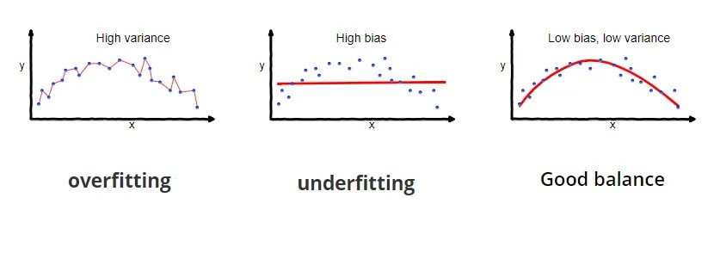
Bias-Variance Tradeoff in a Visual Representation

Slide 7
Models with high bias consistently miss the target, indicating a lack of fit to the data.
Models with high variance hit different parts of the target randomly, representing a high sensitivity to data fluctuations.
We need to find the middle ground where the model consistently comes close to the target, indicating a good balance between bias and variance.

Slide 8
Impact on Model Performance
A model with high bias tends to have low accuracy on both the training and test data. This is because the model oversimplifies the problem, ignoring important patterns.
A model with high variance may have very high accuracy on the training data but poor performance on the test data. They are highly sensitive to the specific instances in the training data, failing to generalize well.

Slide 9
Conclusion
The bias-variance tradeoff is a fundamental concept in machine learning.
Finding the right balance between bias and variance is crucial for building accurate and robust models.
Remember, minimizing both bias and variance leads to optimal model performance.

Slide 10
Thank You
Thank you for your attention!
Feel free to ask any questions.

